Slide 1
I400 – Application Development in Java
Lecture 1
Please fill out this form: https://goo.gl/forms/WasARXEVkNpw2mKP2

Slide 2
Today
CH 1 - IDEs & Eclipse Basics
CH 2 - Language Basics
Variables
Data Types
If you miss anything today, please note that all slides from lecture are posted to Canvas.

Slide 3

Your Instructors
John Duncan (I go by “J”)
PhD, Indiana University
Areas: Education, Security, Privacy, Social Informatics, Pervasive Computing, AI, Cognitive Science
Email: johfdunc@indiana.edu
Office location: Undergraduate Annex 201
Office hours: Monday 2:30 – 4:00 PM or By Appointment
Facilitator, Nothing Is Binary – a SoIC community for students, faculty, and staff who identify as GLBTQ or allies. Talk to me if interested!

Slide 4

Your Instructors
Kay Connelly
PhD, University of Illinois, Champaign-Urbana
Research Areas: HCI, Proactive Health, Ubiquitous Computing
Director of Proactive Health Informatics
Email: connelly@indiana.edu
Office location: Info East 260
Office hour: Thursday 1 – 2 PM or By Appointment

Slide 5

Second Java I400
Welcome to the second time this class has been taught!
Expect some rough patches and changes during the semester.
We promise to take your feedback very seriously, and to work with you to make this class the best class it can be!

Slide 6

Remember!
Treat learning to program like learning a foreign language…
You have to practice using it as much as possible!

Slide 7

AIs and UIs
Graduate (AIs) and Undergraduate (UIs) student assistants.
Introductions
Contact info on Canvas.
If you do well, you could be a UI also.

Slide 8
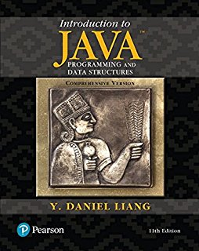
Course Textbook
Intro to Java Programming and Data Structures, by Y. Daniel Liang (11th edition)
Rent or buy here:
https://www.amazon.com/Introduction-Programming-Structures-Comprehensive-Version/dp/0134670949/
Slides, Syllabus, etc. on Canvas
Early assignments submitted on Canvas

Slide 9
Grading
Lecture & Lab Work (20%)
In teams, 1 submission
Same team in lecture & lab
Final Group Project (40%)
A Java application in 2 stages
2 presentations
Documentation & Testing
Individual Homeworks (4) (20%)
Done individually!
Individual Lab Practicals (2) (20%)
Taken during lab, open course materials.
60%
40%

Slide 10
Academic Misconduct
You may not get help from non-instructors or share code on the Homework or the Lab Practicals.
Submissions must be YOUR work only.
DO NOT show/share your individual work with others. This includes asking others to debug your code.
Don’t submit code from the internet as your work.
If you can find it, or buy it, so can we!
The standard penalty for any form of academic misconduct in this course is failure of the course.

Slide 11
Academic Misconduct?
OK
Asking classmates general questions about the course material or concepts.
Working with your group on Lecture or Lab problems assigned to your group.
Writing code with a classmate for practice, as long as you are not working on assigned homework problems.
Asking instructors for help.
NOT OK
Showing your code for a homework problem or Lab Practical to another student.
Sharing solutions to homework or Lab Practicals with anyone not enrolled in the course.
Taking code you didn’t write (even in portions) and submitting it as your work.
Asking anyone other than an instructor for homework help.

Slide 12
Policies
Late Work
Homework (only) will be accepted up to 24 hours late, with a 20% penalty.
Excused Absences
With documentation, you can receive some or all of the points for a lecture or lab you missed. See Canvas for more details.

Slide 13
Lecture Teams
In lecture, we have group work every day –
you’ll sit next to your team members.
Teams will be posted on Canvas soon.
Bringing your laptop to class (and installing Java/Eclipse on it) is a good idea. Don’t forget to charge it before class!
Device policy – no distractions while you’re working! If you are distracted and/or not participating, we can award you a 0 on any problem.

Slide 14
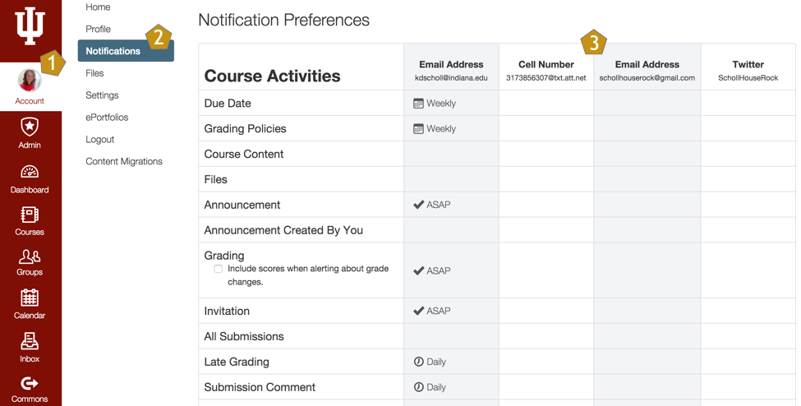
Announcements are Crucial!
Are you getting the Announcements? Would you prefer them in another format?

Slide 15
Why Java?
Java is in many ways the standard language for application development in enterprise.
Java programming opens doors for you, especially when you also know other languages.
Java is used everywhere from servers to mobile devices.
Dr. Connelly teaches an Android Programming class in the Spring that requires Java

Slide 16
Why I400?
This class will give you a grounding in the skills needed to develop applications:
Java Skills (What I210 covers, in 6 weeks)
GIT Skills (Version Control – Why and How)
Application Skills (Your final project)
Implementation
Documentation & Testing
Integration

Slide 17
Download Java for Free
You probably already have some version of Java on your laptop.
Download the latest JDK (Java Development Kit) here:
http://www.oracle.com/technetwork/java/javase/downloads/index.html
Download the latest JRE (Java Runtime Environment) here:
https://java.com/en/download/

Slide 18
Using an IDE
Integrated Development Environment
Common ones for Java include:
Eclipse: The IDE with the most tools/plugins
NetBeans: Sun/Oracle’s original IDE
IntelliJ: Another popular IDE
BlueJ: For small-scale development
DrJava: For small academic projects

Slide 19
Download Eclipse for Free
Visit http://www.eclipse.org/downloads/eclipse-packages/
Choose “Eclipse Installer”, then run it and choose “Eclipse IDE for Java Developers”
or
Choose “Eclipse IDE for Java Developers”
Make sure you choose the correct version for your OS!
At the moment, the latest release is “Oxygen”, aka Version 4.7.0, but that may change.

Slide 20
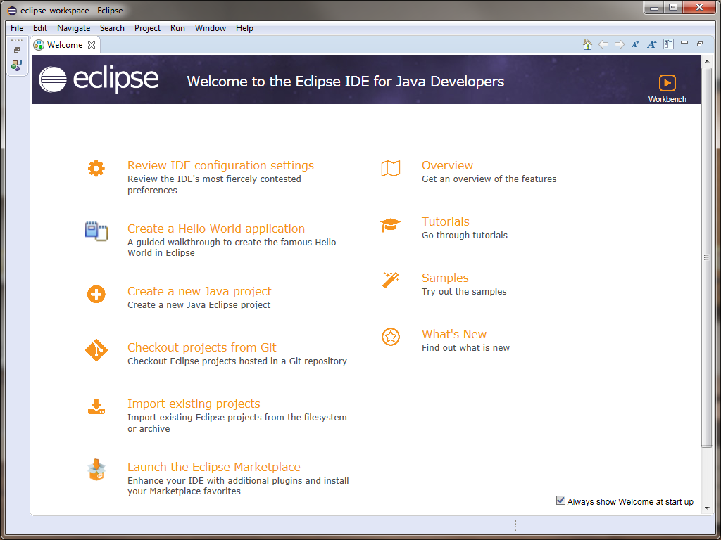
Eclipse
When you first start Eclipse, you’ll see a screen like this:
You can disable this if you like.

Slide 21
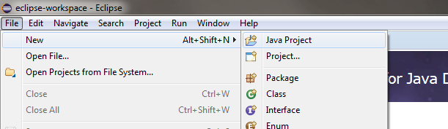
Our First Project (Eclipse)
Start a new Project.

Slide 22
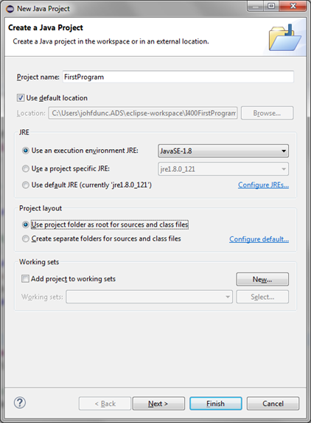
Our First Project (Eclipse)
Let’s set some options.
Then, choose “Finish”

Slide 23
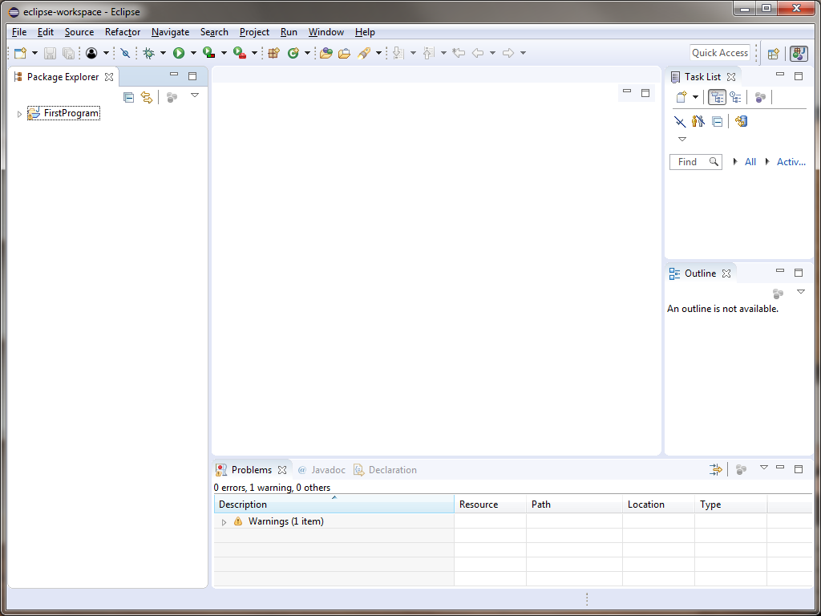
Our First Project (Eclipse)
You should see a screen like this. (You may have to close the Welcome Screen)

Slide 24
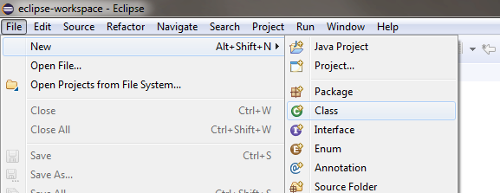
Our First Project (Eclipse)
We need to add a new Class to our Project.

Slide 25
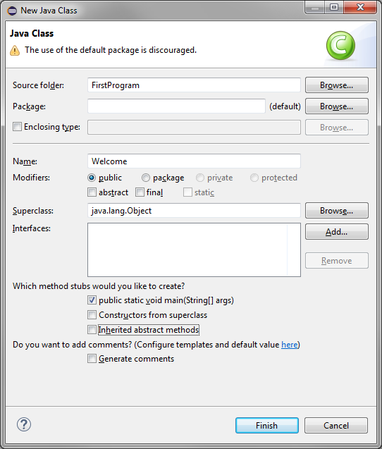
Our First Project (Eclipse)
Let’s set some options.
Uncheck this for now.
Then, choose “Finish”

Slide 26
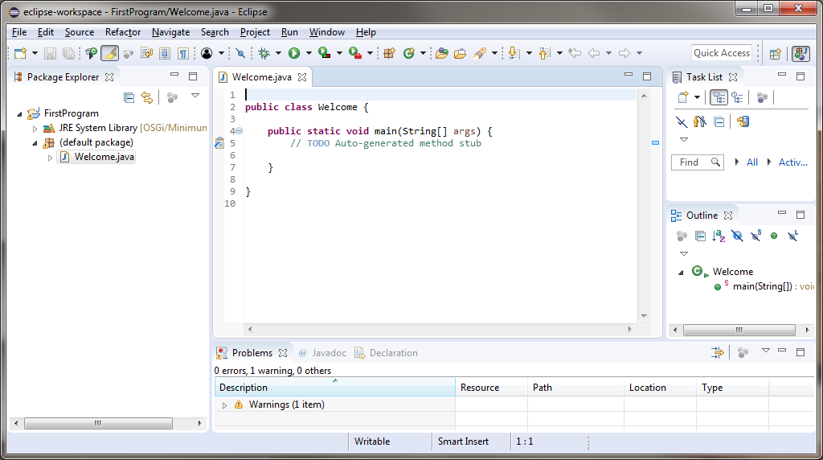
Our First Project (Eclipse)
Now we have a Class in our Project:

Slide 27
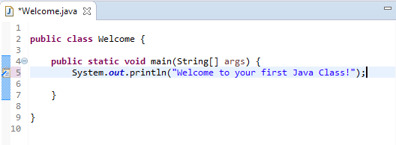
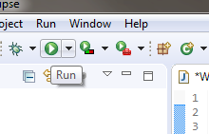
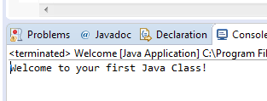
Our First Project (Eclipse)
Let’s add a line of code.
Now click the Run button.
You’ll be prompted to Save, then you should see output!

Slide 28
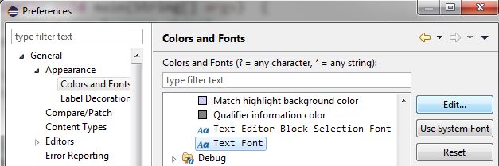
Font Size
If you want to adjust the font size in Eclipse, choose:
The Window menu, then Preferences.
The General section, then Appearance, then Colors and Fonts
The Basic section, then scroll down to “Text Font” and click the Edit… button.
Then the Apply and Close button.

Slide 29
Java Libraries (OOP)
Java uses the Object-Oriented Programming Model (OOP).
The core Java language includes many libraries (System is one of them) that can be invoked to access common functionality.
Inside these libraries are classes, methods, and variables. These libraries are analogous to modules from Python.

Slide 30
Standard Libraries & Classes
System.out.println("Hello World!");
Here, System is a library, and System.out is a variable in the System library that contains a specific PrintStream object.
That object is an instance of the PrintStream class specifically connected to the standard output stream. We’ll learn more about output later.
Documentation on the Standard Libraries and Classes in Java SE 8 is available here: http://docs.oracle.com/javase/8/docs/api/index.html

Slide 31

Line Terminator
In Python, lines simply end whenever you hit Enter/Return. In Java, all statements must end with a semi-colon ;
Eclipse will indicate if you have a syntax error on a line:

Slide 32

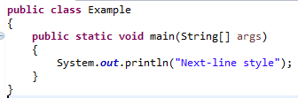
Blocks in Java
In Python, code blocks were simply determined by indentation.
In Java, you must explicitly indicate them with curly braces { } . There are two major styles, End-of-Line and Next-Line:

Slide 33


Comments
Any line that begins with // will be treated as a comment:
Multi-line comments begin with /* and end with */

Slide 34

Java Program Basics
Every Java Program will have at least 1 class. That class will have at least 1 method, main().
So the basic template of a Java program is:
It’s convenient to have Eclipse set this up for us.

Slide 35
Naming Variables in Java
Use lowercase names for variables and methods that are one word.
radius, print
If the name is more than one word, capitalize the first letter of each successive word (called camelCase).
computeDiameter, printTable
Class names begin with a capital letter.
Car, Database

Slide 36
Declaring Values
In Python, variables are declared in an identical manner to assigning them a value:
temperature = 78
However, in Java, when you declare a variable, you must declare its type as well.
int temperature = 78;
String name = "Bob";

Slide 37
Declaring Values
Multiple variables can be declared at once, if they are of the same type:
int number1, number2, number3;
You can even declare multiple variables and their values on one line:
double gpa1 = 3.4, gpa2 = 4.0, gpa3 = 2.76;

Slide 38
Declaring Values
Constants (variables whose value does not change) are named with ALL_UPPERCASE and underscores between words.
Constants are declared with the additional keyword final :
final double PI = 3.14159;
final int PERFECT_SCORE = 100;

Slide 39
Working with Numbers
Ints: Numbers without a decimal part
int numStudents = 10;
Doubles (Floating-Point Numbers): Numbers with a decimal part (even if it’s .0)
double gpa;
Note that we can choose not to specify a starting value for a variable!

Slide 40
Numeric Types
Java actually has 6 types of numbers!
Name | Type | Range | Storage Size
byte | integer | -128 to 127 (-2⁷ to 2⁷ -1) | 8-bit signed
short | integer | -32768 to 32767 (-2¹⁵ to 2¹⁵ -1) | 16-bit signed
int | integer | -2³¹ to 2³¹ -1 | 32-bit signed
long | integer | -2⁶³ to 2⁶³ -1 | 64-bit signed
float | decimal | Large | 32-bit IEEE 754
double | decimal | Largest | 64-bit IEEE 754

Slide 41
Working with Numbers
We’ll mostly use ints and doubles.
Be careful about which one you want! Could a decimal point be involved at all?
If so, choose double.

Slide 42
Mathematical Operators
Operator | Description | Example
+ | Addition | 7 + 3
- | Subtraction | 7 – 3
* | Multiplication | 7 * 3
/ | Division | 7 / 3
% | Modulus (remainder under integer division) | 7 % 3

Slide 43
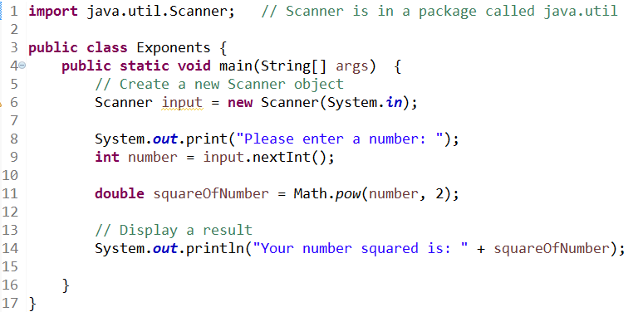

Mathematical Operators
For exponentiation, we can use Math.pow(), which returns a double. Note that like System, we do not need to import Math.

Slide 44
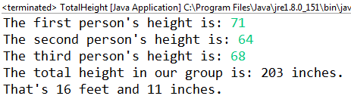
Total Height (Group Work)
Working with the people around you, write a class called TotalHeight that calculates the total height of all of your group members, in inches (There are 12 inches to a foot). Additionally, convert the total height in inches into feet and inches.
Take a look at the code for the Exponents class to see how to accept input from the console! (We’ll learn more next time)
Don’t write over your old code – just add a new class to your current Package.

Slide 45
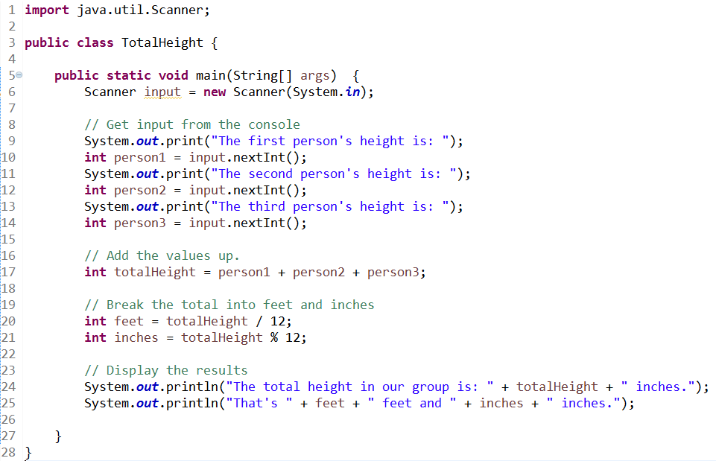
Total Height (Answer)

Slide 46
Questions?

